Slide 1
DSO104C in Tableau
Lesson 6 Hands On
Darren Besabella

Slide 2
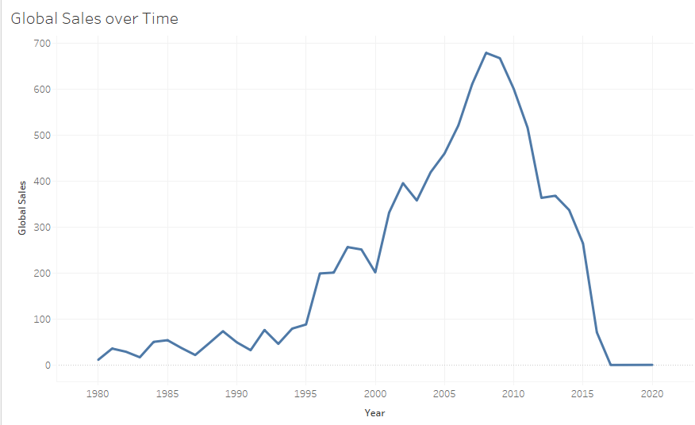
How video game sales have been trending over time?

Slide 3
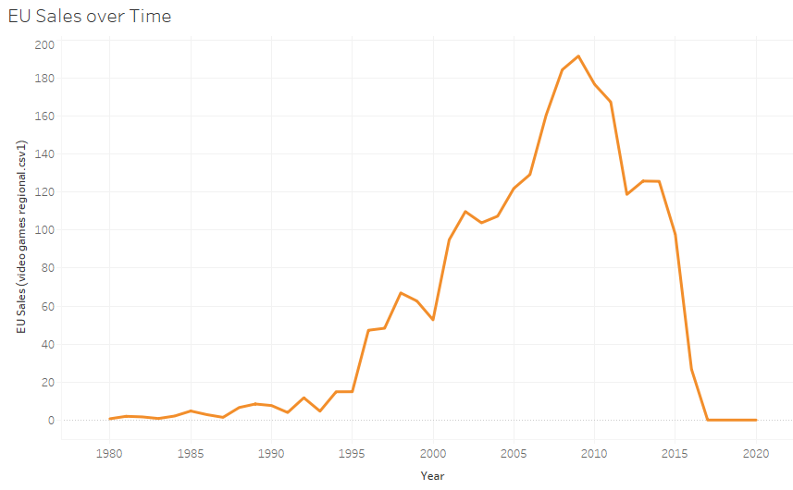
How video game sales have been trending over time?

Slide 4
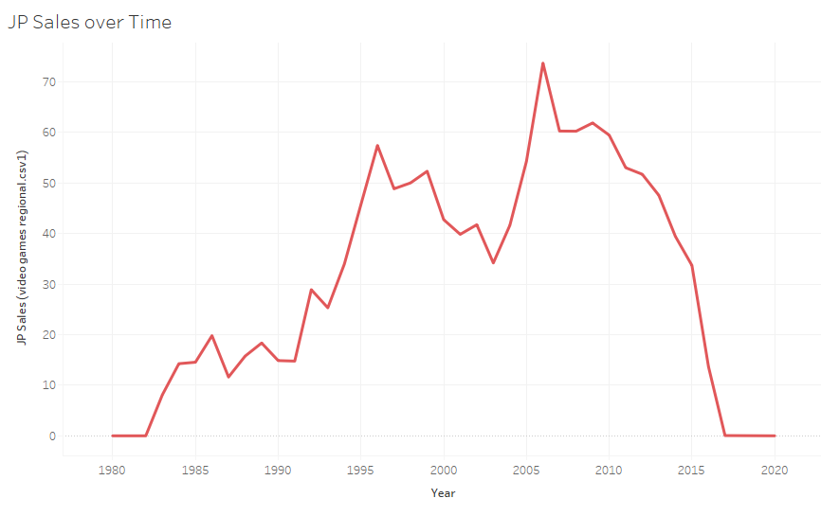
How video game sales have been trending over time?

Slide 5
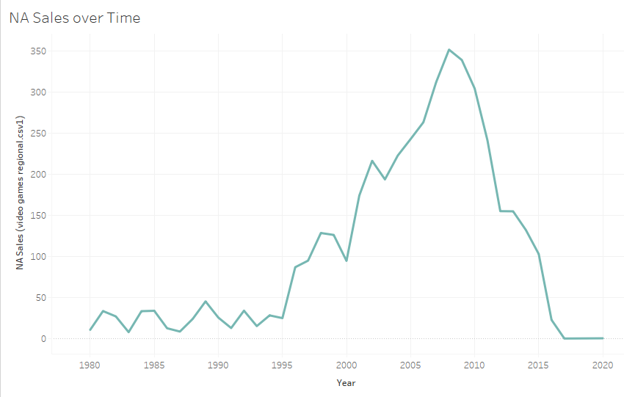
How video game sales have been trending over time?

Slide 6
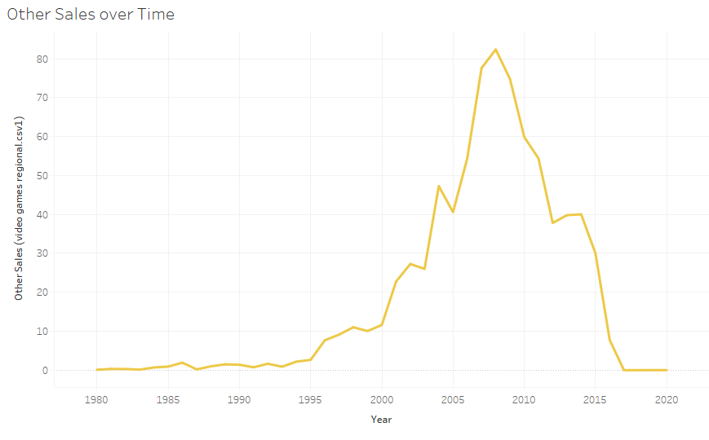
How video game sales have been trending over time?

Slide 7
How video game sales have been trending over time?
During the time frame of 2008 to 2010, video game sales has peaked.
The data set is between 1980 to 2020. It was a very slow build up but after 2010 it has been tearing down faster.

Slide 8
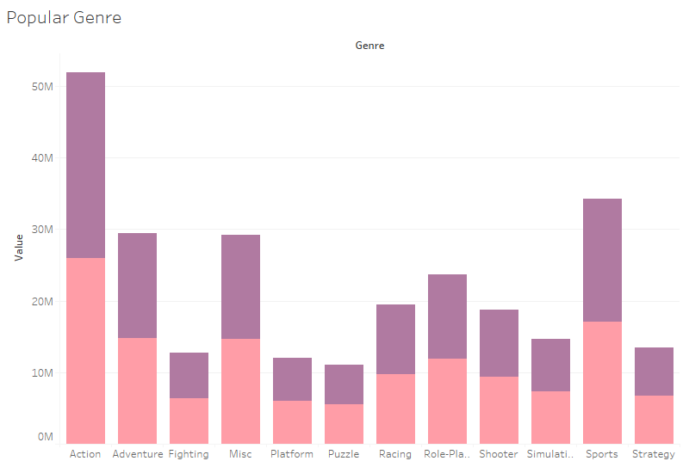
The most popular genre of video game

Slide 9
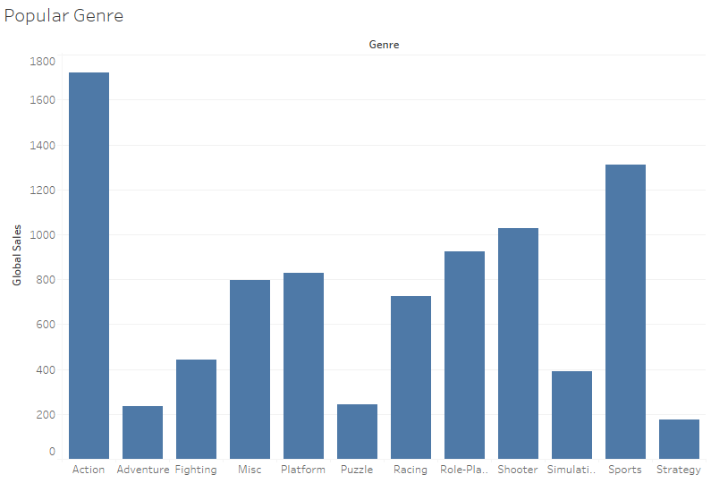
The most popular genre of video game

Slide 10
The most popular genre of video game
In Rank it is gonna be Action, Sports, and Adventure.
In Global Sales it is gonna be Action, Sports, and Shooter.

Slide 11
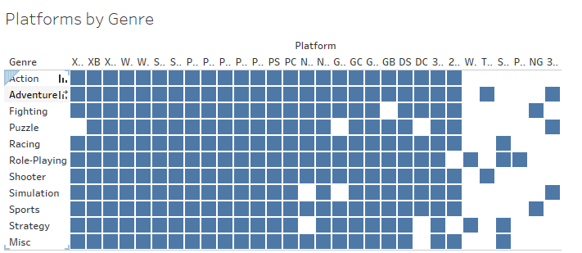
A comparison of video game platforms by genre

Slide 12
A comparison of video game platforms by genre
Availability wise on Platforms the top Genres are:
Adventure and Role-Playing at 26 platforms
Racing, Shooter, and Sports at 25 platforms

Slide 13
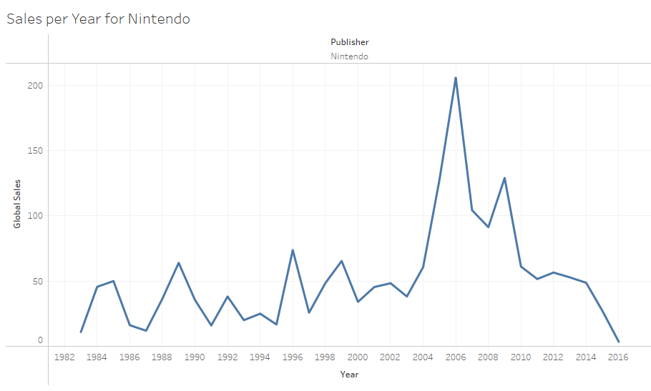
A visual looking at only games by Nintendo

Slide 14
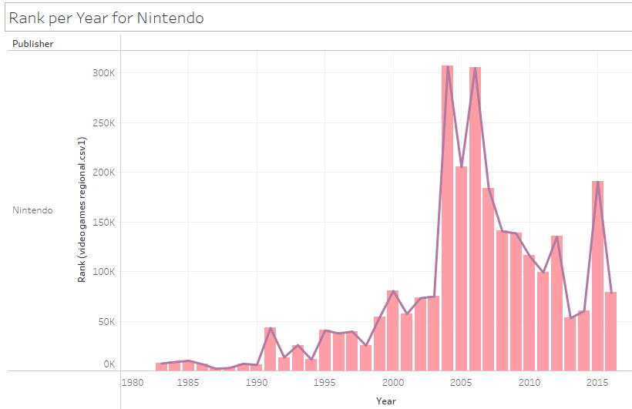
A visual looking at only games by Nintendo

Slide 15
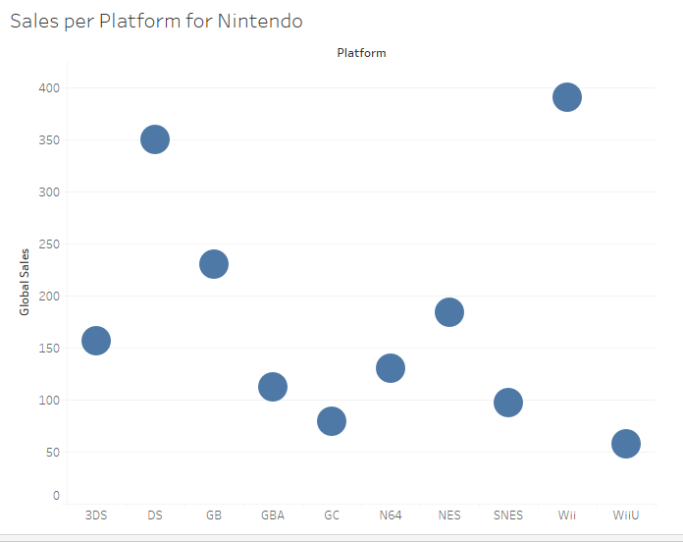
A visual looking at only games by Nintendo

Slide 16
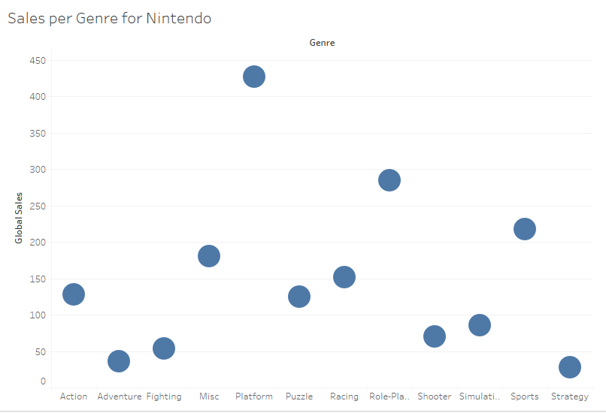
A visual looking at only games by Nintendo

